Slide 1
Grammatical Profiles and the Aspect of Old Church Slavonic Verbs
Laura A. Janda & Hanne Martine Eckhoff
University of Tromsø
University of Oslo
Centre for Advanced Studies, Norwegian Academy of Sciences

Slide 2
Main Idea:
Did Old Church Slavonic have lexical aspect?
  lexical aspect – expressed as perfective/imperfective pairs of verbs
  inflectional aspect – aspectually driven distinction between inflectional forms (imperfect, aorist, perfect)
We take an agnostic perspective and apply objective statistical methods to address this question.

Slide 3
Overview
Brief review of the controversy
What is a grammatical profile?
What is the relationship between grammatical profiles and lexical aspect in Russian?
What do grammatical profiles of OCS verbs look like and what are the implications for lexical aspect?

Slide 4
Brief review of the controversy:
Is Slavic lexical aspect system prehistoric or of more recent provenience?
Prehistoric
Recent
Kuryłowicz 1929, Meillet 1934, Vaillant 1948 & 1966, Kuznecov 1953, Dostál 1954, Němec 1956 and 1958, Kölln 1957, Maslov 1961, Borkovskij and Kuznecov 1965, Gorškova and Xaburgaev 1981, Schenker 1993, Lunt 2001, Andersen 2009
Borodič 1953, Ruzicka 1957, Budich 1969, Bermel 1997, Nørgård-Sørensen 1997, Dickey 2007
Reasons: Uneven modern distribution of aspectual phenomena in Slavic

Slide 5
Brief review of the controversy:
Is Slavic lexical aspect system prehistoric or of more recent provenience?
Current status of the debate
  A lot of polemics
  Analyses of individual examples
  Generalizations are mostly intuitive
  Conflicting results
We bring something new to the debate:
  Objective empirical study based on data from the PROIEL Corpus, a parallel corpus of Ancient Greek, Old Church Slavonic, Classical Armenian, Gothic, Latin
Notes:
Often worked with constructed examples

Slide 6

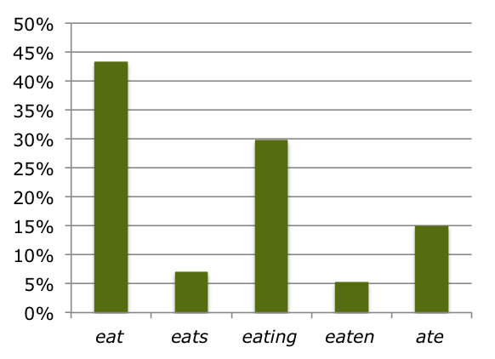
What is a grammatical profile?
Distribution of verb forms:
    eat 749 M
    eats 121 M
    eating 514 M
    eaten 88.8 M
    ate 258 M
The grammatical
profile of eat
Notes:
Figures from google – this is NOT a scientific way to do grammatical profiles, but it gives us a rough approximation to illustrate

Slide 7
What is the relationship between grammatical profiles and lexical aspect in Russian?
Janda & Lyashevskaya 2011 presented a study of grammatical profiles of Russian verbs based on nearly 6M verb forms attested in the Russian National Corpus
Result:
  There is a strong relationship between aspect and grammatical profiles in Modern Russian
  The difference between perfective and imperfective verbs is statistically significant and the effect size is robust

Slide 8
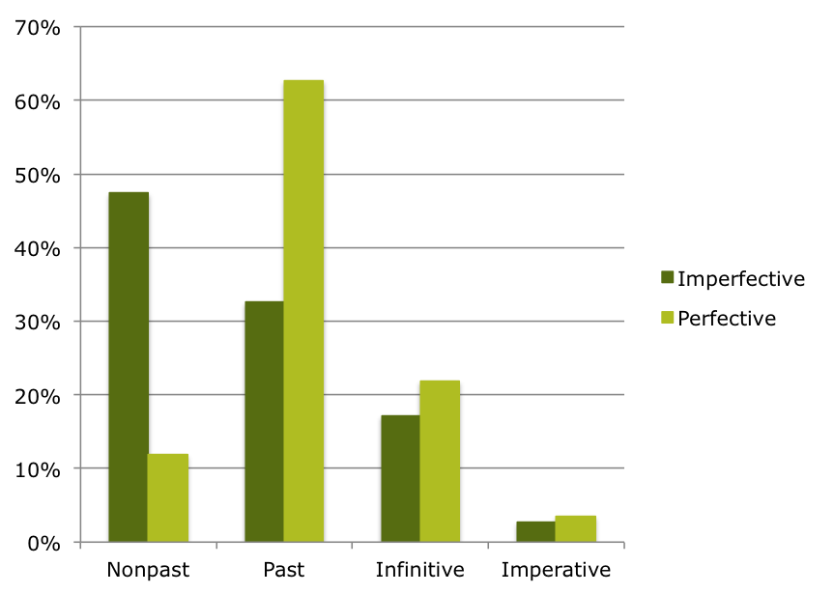
Grammatical Profiles of Russian Verbs
 | Nonpast | Past | Infinitive | Imperative
Imperfective | 1,330,016 | 915,374 | 482,860 | 75,717
Perfective | 375,170 | 1,972,287 | 688,317 | 111,509
chi-squared = 947756
df = 3
p-value < 2.2e-16
effect size (Cramer’s V) = 0.399 (medium-large)
Notes:
Based on verbs with 100 or more attestations in RNC

Slide 9
Modern Russian vs. OSC
Modern Russian
OCS
We know that modern Russian has lexical aspect
We know which Russian verbs are perfective and which are imperfective
We know that aspect is associated with grammatical profiles in modern Russian
We don’t know whether OCS had lexical aspect
We don’t know which verbs were perfective and imperfective (though some have classified them; cf. Dostál 1954)
Could the grammatical profiles of OCS verbs indicate whether there was lexical aspect?

Slide 10
Our strategy
Run the Janda & Lyashevskaya 2011 study in reverse for OCS
Collect data on the grammatical profiles of OCS verbs
Feed grammatical profiles (and no other information) into statistical programs and ask them to sort verbs into groups
Do the resulting groups align with what we would expect if OCS did have lexical aspect?

Slide 11
Hypothesis of Grammatical Profiles and Aspect in Old Church Slavonic:
If there is an aspectual distinction between perfective and imperfective verbs in Old Church Slavonic, it can be discovered on the basis of the grammatical profiles of verbs.

Slide 12
Our data
Extracted from OCS portion of PROIEL corpus = 62,000 words
Our PROIEL sample contains 15,720 attestations of OCS verbs tagged for: source, lemma, verb form, and properties of the verbs’ dependents
Excludes byti (comparison shows this does not make a big difference)
Excludes verbs with <20 attestations
Our data: 9,694 attestations of 129 verbs
Subparadigms: aorist, imperative, imperfect, infinitive/supine, present, past participle, and present participle

Slide 13
Grammatical profiles of two OCS verbs: tvoriti ‘make’ and jęti ‘take’
To obtain the grammatical profile of a verb:
  Count up attestations for each subparadigm
  Calculated distribution across subparadigms in terms of percentages
 | Aorist | Imperative | Imperfect | Infinitive | Past participle | Present | Present participle
tvoriti ‘make’ | 0 0% | 14 8% | 12 7% | 23 13% | 0 0% | 99 57% | 26 15%
jęti ‘take’ | 25 28% | 7 8% | 0 0% | 10 11% | 20 22% | 28 31% | 0 0%
Notes:
Can we run this backwards in OCS?

Slide 14
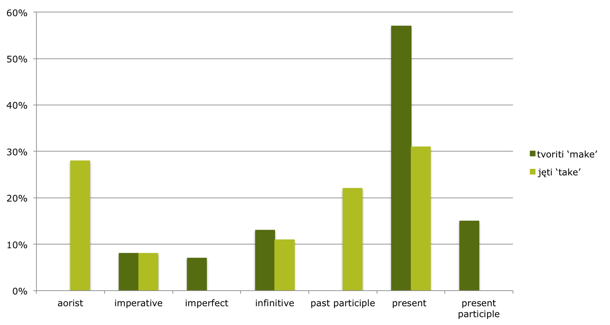
Grammatical profiles of tvoriti ‘make’ and jęti ‘take’
Notes:
This looks promising, so now we will look at the rest of the verbs, all those with 20 or more forms in PROIEL

Slide 15
Two statistical programs sort the verbs
Two statistical programs were fed the grammatical profiles of the 129 Old Church Slavonic verbs
Correspondence analysis:
  Chi-square distances between rows and columns in matrix projected onto a two-dimensional map
  Calculates a series of factors accounting for progressively less and less of the variance
  Factor 1 (x-axis) accounts for 39% of variance and divides the verbs into two groups: “lefties” and “righties”
  “lefties” look like imperfective verbs, “righties” look like perfective verbs; 96% correspondence to Dostál
Hierarchical cluster analysis:
  Divisive clustering approach, partitioning data into progressively smaller clusters
  Sorting of verbs is 95% identical to correspondence analysis

Slide 16
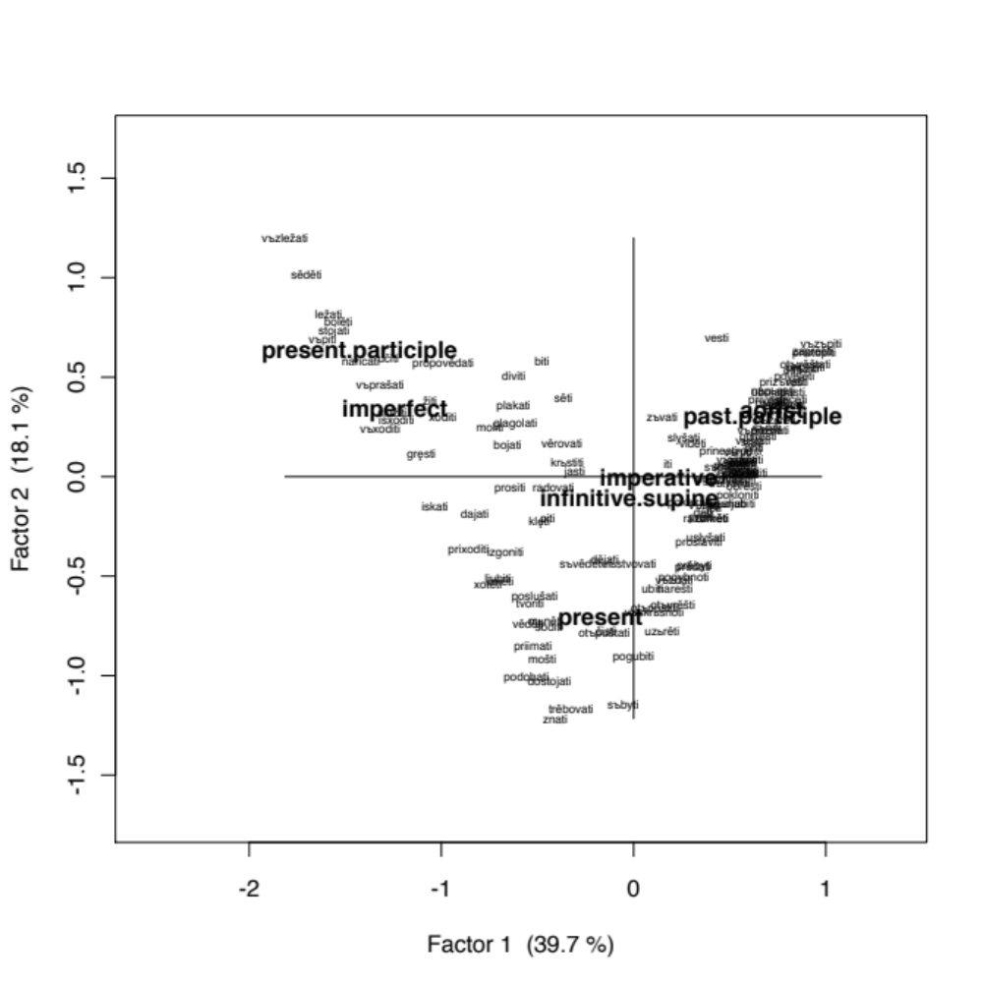
Correspondence analysis results
See Table 1 and Table 2 on handout

Slide 17
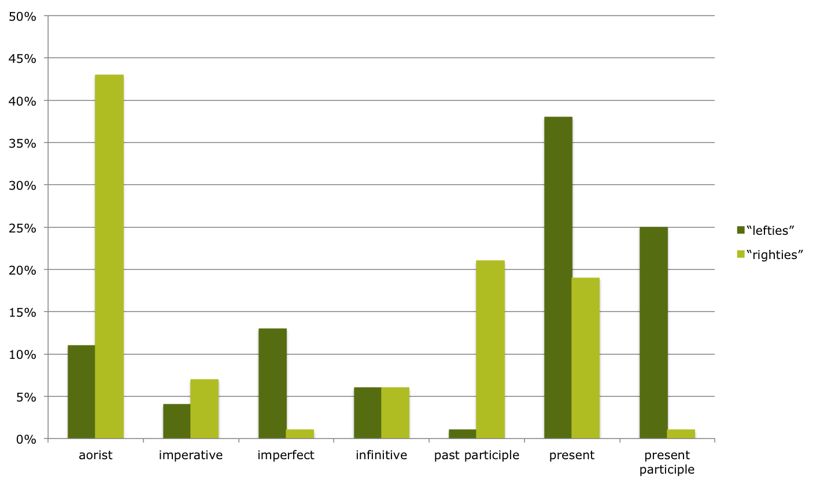
Grammatical Profiles of
“lefties” vs. “righties”

Slide 18
Results of correspondence analysis
States consistently receive negative Factor 1 values: vъzležati ‘lie (at table)’ -1.81, sěděti ‘sit’ -1.70, ležati ‘lie’ -1.59, stojati ‘stand’ -1.56, bolěti ‘be ill’ -1.54, naricati sę ‘be called’ -1.42, žiti ‘live’ -1.06, xotěti ‘want’ -0.76, ljubiti ‘love’ -0.70, iměti ‘have’ -0.69, bojati sę ‘fear’ -0.65, diviti sę ‘be surprised’ -0.62, podobati ‘be fitting’ -0.56, věděti ‘know’ -0.55, mošti ‘be able’ -0.47, mьněti sę ‘think, believe’ -0.46, dostojati ‘befit’ -0.44, radovati sę ‘rejoice’ -0.42, znati ‘know’ -0.41, věrovati ‘believe’ -0.37, trěbovati ‘need’ -0.32
Mostly consistent sorting of potential aspectual pairs (imperfectives with negative values, perfectives with positive ones) – see table on handout; exceptions: pьsati ‘write’ 0.71 vs. napьsati ‘write’ 0.73 and slyšati ‘hear’ 0.26 vs. uslyšati ‘hear, find out’ 0.38 (see Table 3 on handout)

Slide 19
Results of correspondence analysis
Nine verbs deviate from Dostál’s designations (see Table 4 on handout)
  Eight of them are located toward the middle, with Factor 1 values between -0.5 and +0.5 (exception: pьsati ‘write’ 0.71)
  Three are “lefties” that Dostál classifies as perfectives or mostly perfective biaspectuals
  Six are “righties” that Dostál classifies as imperfectives or mostly imperfective biaspectuals
  Eight of nine “mismatched” verbs are simplex stems lacking overt markers of lexical aspect

Slide 20
Conclusions
OCS verbs can be classified into two groups based on their grammatical profiles
This suggests that there was lexical aspect in OCS
The distinction is similar to, but not identical to what we observe in Modern Russian
Both Russian perfective verbs and OCS “righties” prefer past tense: 63% of Russian perfectives are in the past tense, and 43% of the “righties” occur in the aorist
Both Russian imperfectives and OCS “lefties” predominantly occur in the nonpast/present tense – 47% of the imperfectives and 38% of the “lefties”

Slide 21
Conclusions, cont’d.
Although many scholars have claimed that Old Church Slavonic does not have clear paradigmatic restrictions for aspect, our results suggest that the distinction between the aorist and the imperfect, and likewise between the past (active) and the present (active) participles, was aspectual in nature and interacted with lexical aspect
  imperfect is very rare for “righties”
  present participle is very rare for “righties”

Slide 22
References
Amse-De Jong, Tine. 1974. The meaning of the finite verb forms in the Old Church Slavonic Codex Suprasliensis. A synchronic study. The Hague: Mouton.
Andersen, Henning. 2009. On the origin of the Slavic aspects: Questions of chronology. Vit Bubenik, John Hewson and Sarah Rose (eds.). Grammatical change in Indo-European languages. Papers presented at the Workshop on Indo-European linguistics at the 18th International Conference on Historical Linguistics, Montreal, 2007. 123–140. Amsterdam: John Benjamins.
Baayen, R.H. 2008. Analyzing Linguistic Data. A Practical Introduction to Statistics Using R. Cambridge: Cambridge University Press.
Bermel, Neil. 1997. Context and the Lexicon in the Development of Russian Aspect. Berkeley: University of California Press.
Borkovskij, V.I. and P.S. Kuznecov. 1965. Istoričeskaja grammatika russkogo jazyka. Moscow: Nauka.
Borodič, V.V. 1953. K voprosu o formirovanii soveršennogo i nesoveršennogo vida v slavjanskix jazykax. Voprosy jazykoznanija 2:68–86.
Budich, Wulf. 1969. Aspekt und verbale Zeitlichkeit in der I. Novgoroder Chronik. Graz: Akademischer Druck- u. Verlagsanstalt.

Slide 23
References, p. 2
Dickey, Stephen. 2000. Parameters of Slavic Aspect: A Cognitive Approach. Stanford: CSLI Publications.
Dickey, Stephen. 2007. A Prototype Account of the Development of Delimitative PO- in Russian. Dagmar Divjak and Agata Kochanska (eds.). Cognitive Paths into the Slavic Domain. Berlin: Mouton de Gruyter, 326—371.
Divjak, Dagmar S. and Stefan Th. Gries. 2006. Ways of trying in Russian: clustering behavioral profiles. Corpus Linguistics and Linguistic Theory 2,1:23–60.
Dostál, Antonin. 1954. Studie o vidovém systému v staroslověnštině. Prague: Státní pedagogické nakladatelství.
Galton, Herbert. 1976. The main functions of the Slavic verbal aspect. Skopje: Macedonian Academy of Sciences and Arts.
Gorškova, K.V. and G.A. Xaburgaev. 1981. Istoričeskaja grammatika russkogo jazyka. Moscow: Vysšaja škola.
Divjak, Dagmar and Stefan Th. Gries. 2009. Corpus-based cognitive semantics: A contrastive study of phasal verbs in English and Russian. Katarzyna Dziwirek and Barbara Lewandowska-Tomaszczyk (eds.). Studies in cognitive corpus linguistics. 273–296. Frankfurt am Main: Peter Lang.

Slide 24
References, p. 3
Janda, Laura A. 2006. A Metaphor for Aspect in Slavic. Henrik Birnbaum in Memoriam (= International Journal of Slavic Linguistics and Poetics 44-45). 249-60.
Janda, Laura A. and Olga Lyashevskaya. 2011. Grammatical profiles and the interaction of the lexicon with aspect, tense and mood in Russian. Cognitive Linguistics 22,4:719­–763.
Kölln, Herrmann. 1957. Vidové problémy v staroslověnštině. Universitatis Carolina, Philologica 3,1:67–100.
Kuryłowicz, Jerzy 1929. La genèse des aspects verbaux slaves. Prace filologiczne 14:644–657.
Kuznecov, P.S. 1953. K voprosu o genezise vido-vremennyx otnošenij drevnerusskogo jazyka. Trudy instituta jazykoznanija AN SSSR 2:220–253.
Kuznetsova, Julia. Forthcoming. Linguistic Profiles: Correlations between Form and Meaning. PhD dissertation, University of Tromsø.
Lunt, Horace. 1959/1969. Old Church Slavonic Glossary. Cambridge MA: Harvard University, Department of Slavic Languages and Literatures.
Lunt, Horace. 2001. Old Church Slavonic Grammar. Seventh revised edition. Berlin: Mouton de Gruyter.

Slide 25
References, p. 4
Maslov, Ju.S. 1961. Rol’ tak nazyvaemoj perfektivacii i imperfektivacii v processe vozniknovenija slavjanskogo glagol’nogo vida. Issledovanija po slavjanskomu jazykoznaniju. 165–195. Moscow: Izdatel’stvo AN SSSR.
Meillet, Antoine. 1934. Le slave commun. Paris: H. Champion.
Němec, Igor. 1956. Kategorie determinovanosti a indeterminovanosti jako základ slovanské kategorie vidu. Slavia 25,4:299–317.
Němec, Igor. 1958. Genese slovanského systému vidového. Rozpravy ČSAV, Řada společenských věd 68,7. Prague: Nakladatelství ČSAV.
Newman, John. 2008. Aiming low in linguistics: Low-level generalizations in corpus-based research. Proceedings of the 11th International Symposium on Chinese Languages and Linguistics, National Chiao Tung University, Hsinchu, Taiwan. May 24 2008. http://www.ualberta.ca/~johnnewm/Aiming%20Low.pdf.
Newman, John and Sally Rice. 2006. Transitivity schemas of English EAT and DRINK in the BNC. S. Th. Gries and A. Stefanowitsch (eds.). Corpora in Cognitive Linguistics: Corpus-based Approaches to Syntax and Lexis. 225-260. Berlin and New York: Mouton de Gruyter.
Nørgård-Sørensen, Jens. 1997. Tense, aspect and verbal derivation in the language of the Novgorod birch bark letters. Russian Linguistics 21:1–21.

Slide 26
References, p. 5
Rice, Sally and John Newman. 2005. Inflectional islands. Presentation at the 9th International Cognitive Linguistics Conference, Yonsei University, Seoul, Korea. Available at http://www.ualbera.ca/~johnnewm.
Ruzicka, Rudolf. 1957. Der Verbalaspekt in der altrussischen Nestorchronik. Berlin: Akademie-Verlag.
Schenker, Alexander M. 1993. Proto-Slavonic. Bernard Comrie and Greville G. Corbett (eds.). The Slavonic Languages. 60-124. London: Routledge.
Schuyt, Roel. 1990. The morphology of Slavic verbal aspect: A descriptive and historical study. Amsterdam: Rodopi.
Šteinfeldt, E. 1970. Russian Word Count. Moscow: Progress.
Vaillant, André. 1948. Manuel du vieux slave. v. I : Grammaire. Paris: Institut d’études slaves.
Vaillant, André. 1966. Grammaire Comparée des langues slaves. v. III: Le verbe. Paris: Klincksieck.
van Wijk, Nicolaas. 1929. Sur l’origine des aspect du verb slave. Revue des études slaves 9:237–252.

